Slide 1
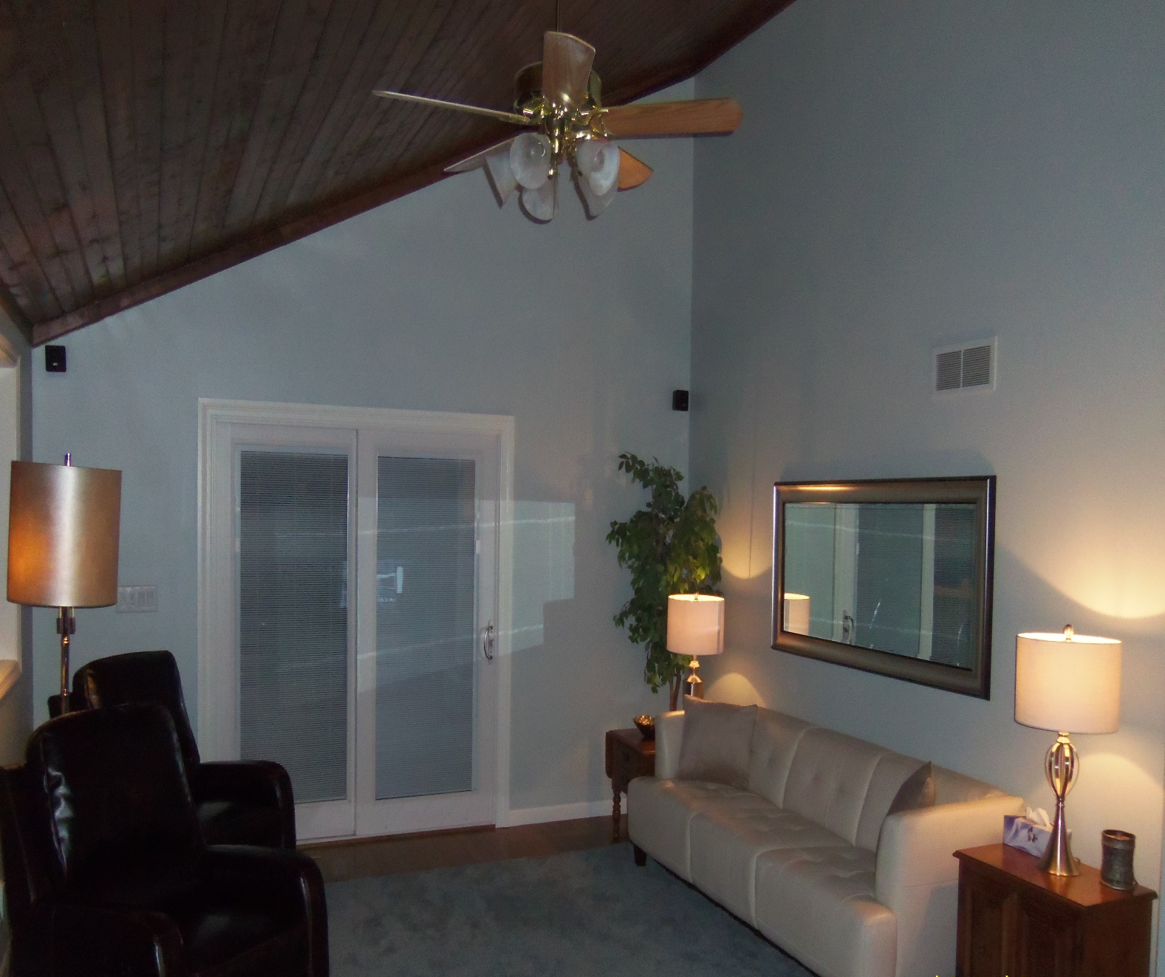
BEFORE
AFTER
AREA: LIVING ROOM

Slide 2
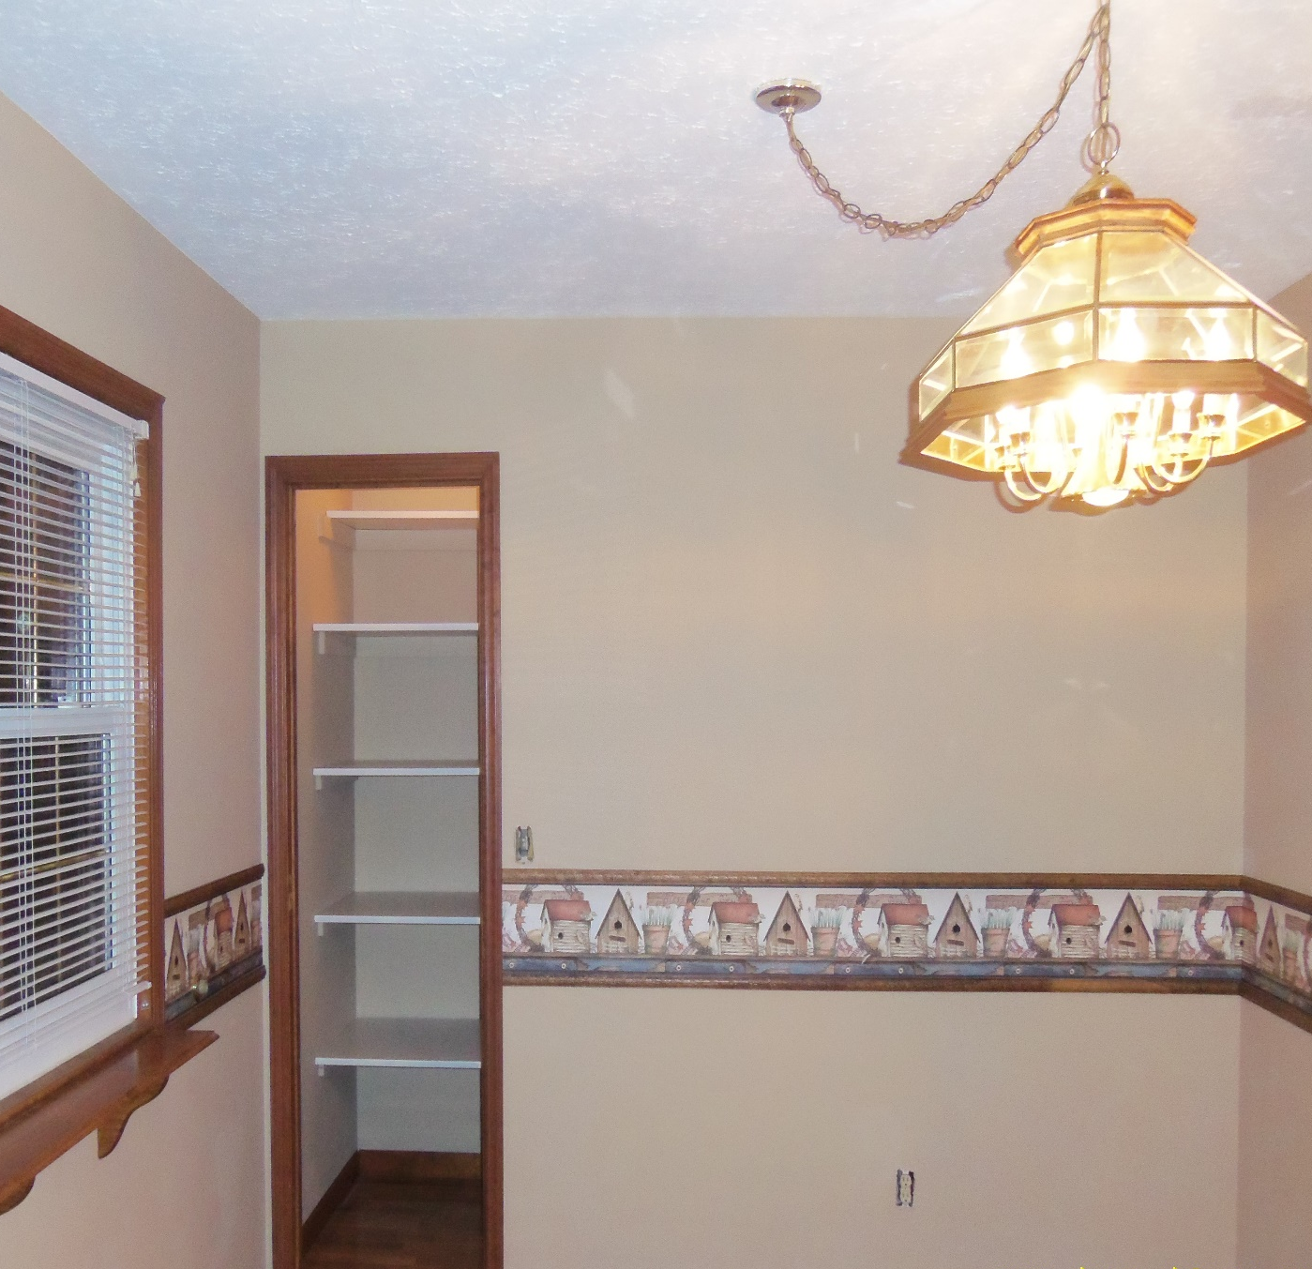
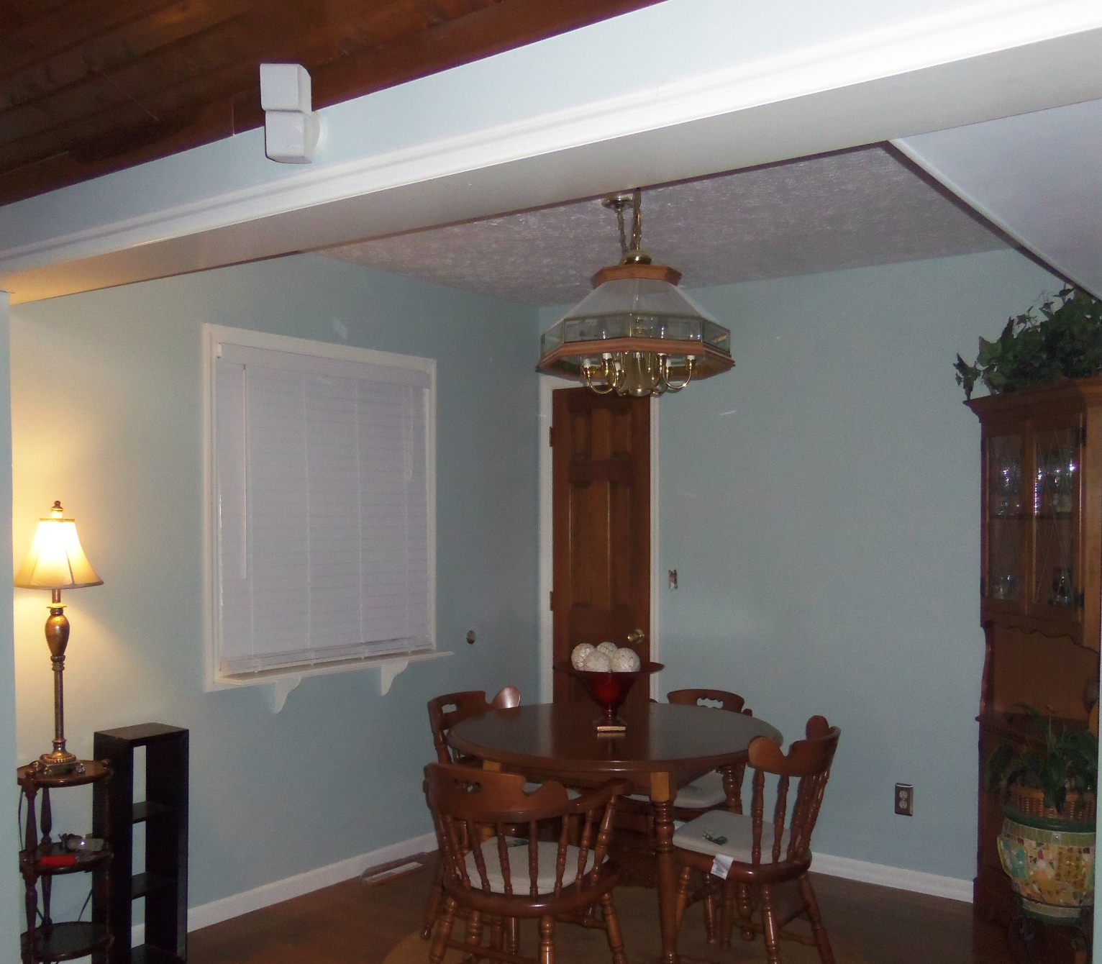
BEFORE
AFTER
AREA: DINING ROOM

Slide 3
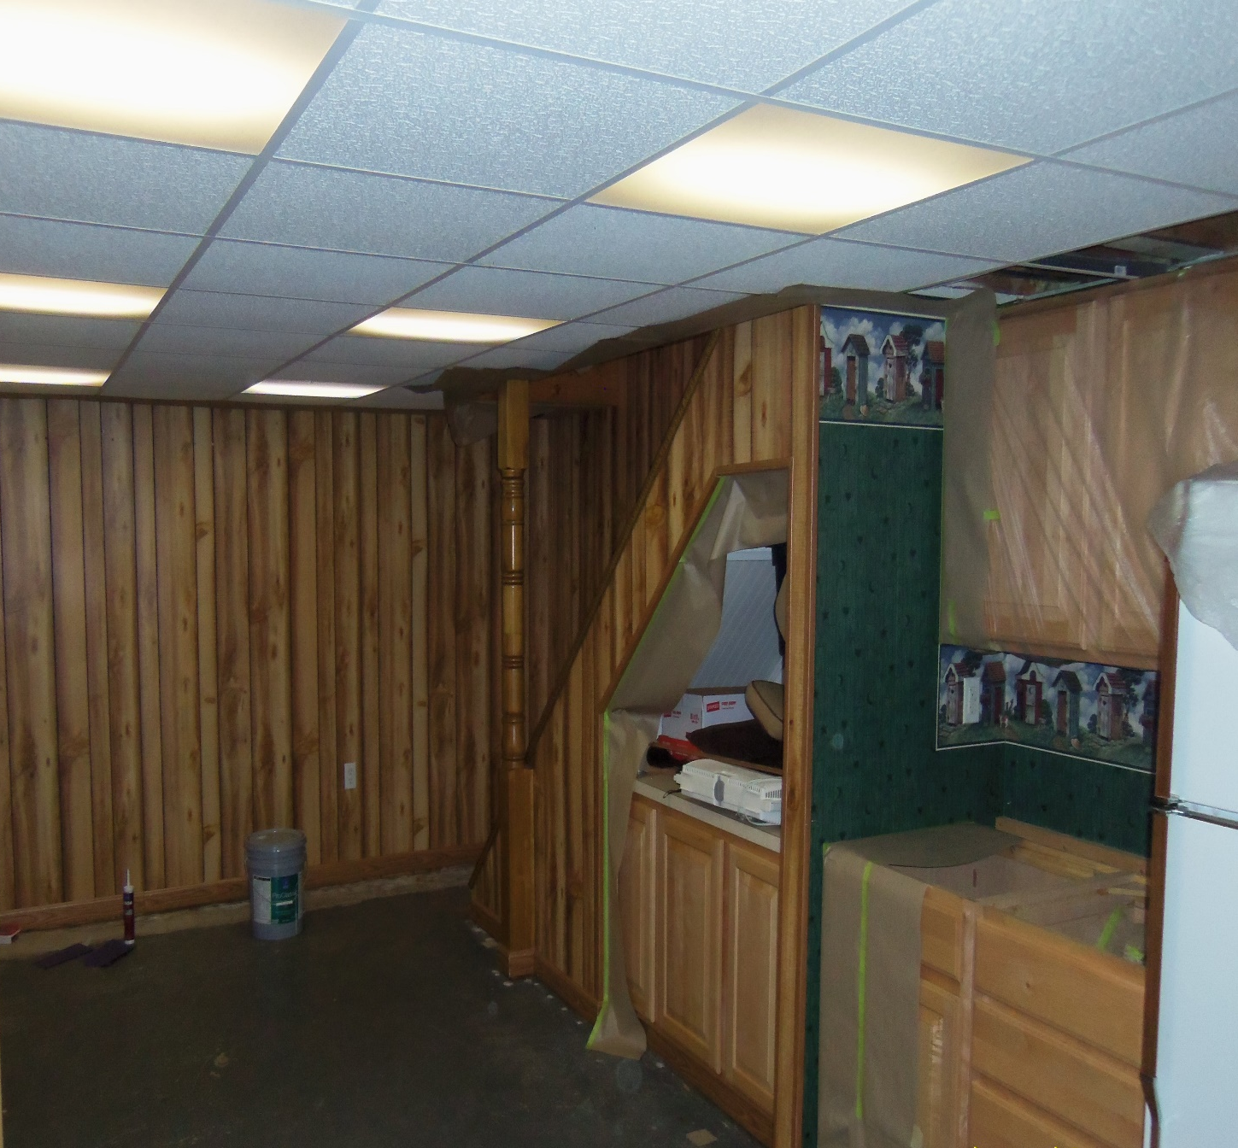
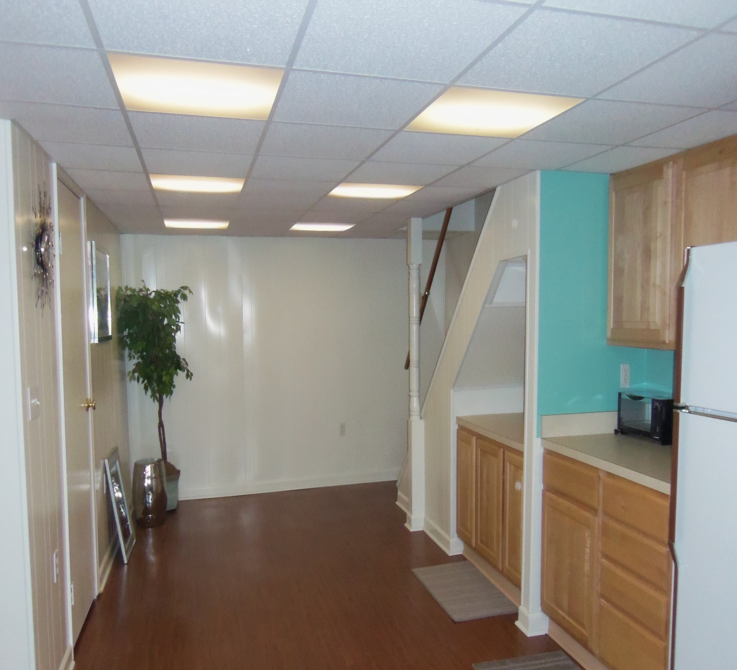
BEFORE
AFTER
AREA: BASEMENT

Slide 4
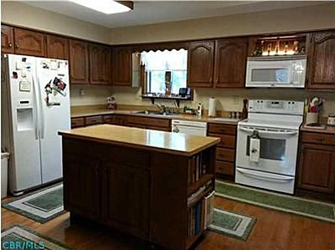
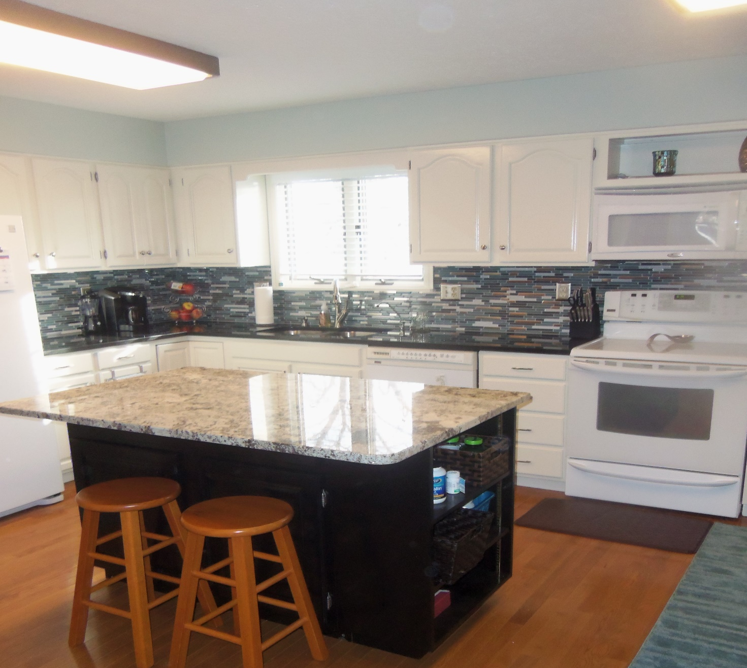
BEFORE
AFTER
AREA: KITCHEN
*Painted the cabinets and walls

Slide 5
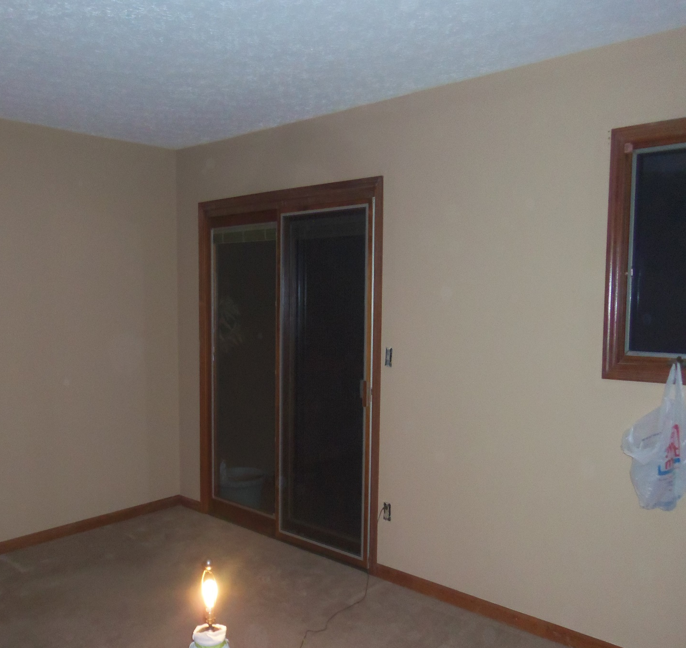
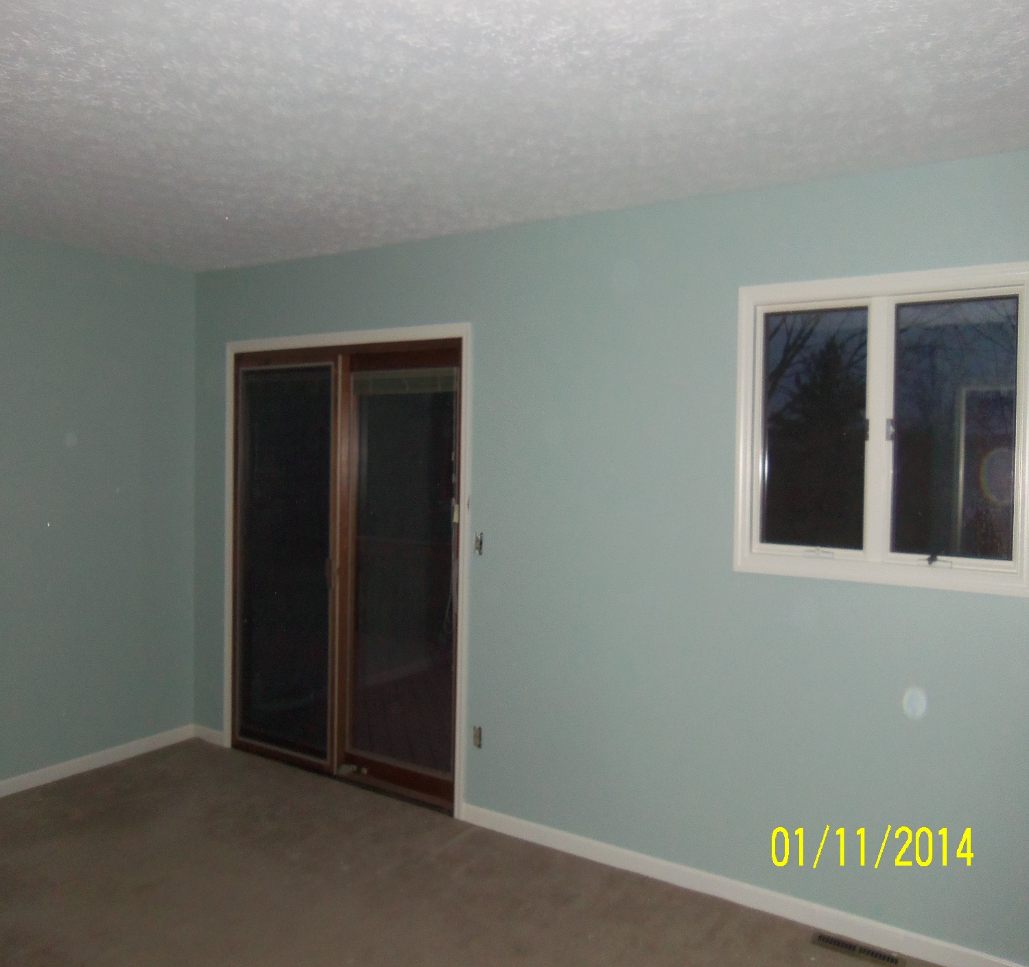
BEFORE
AFTER
AREA: MASTER BEDROOM

Slide 6
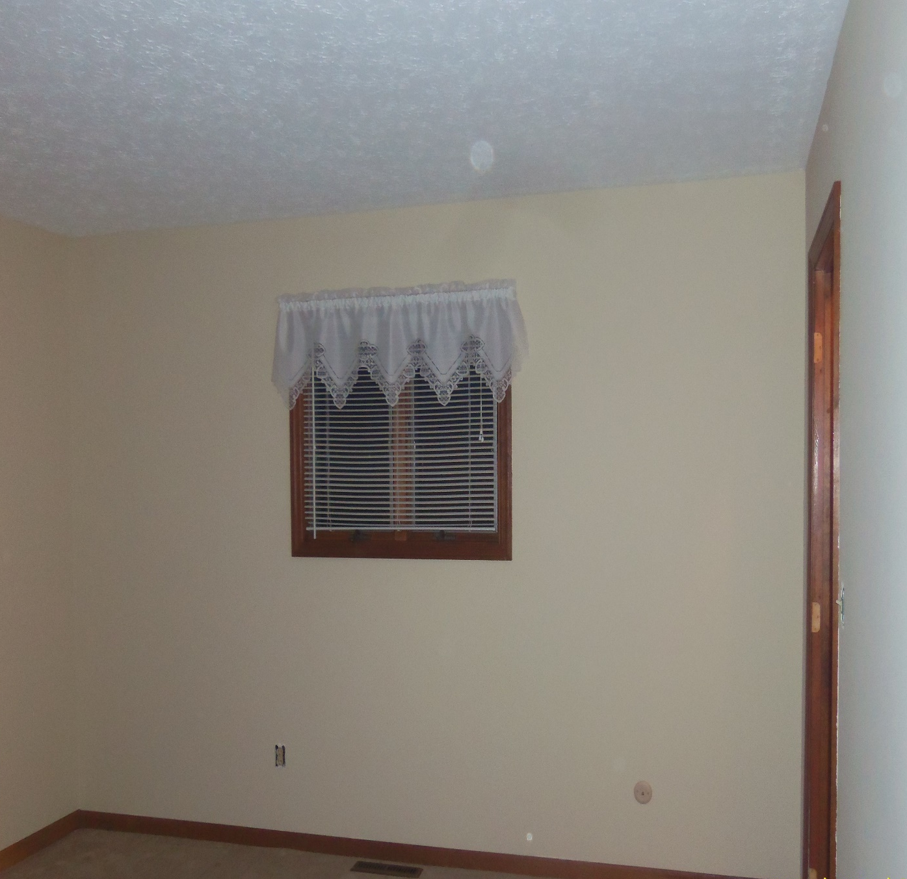
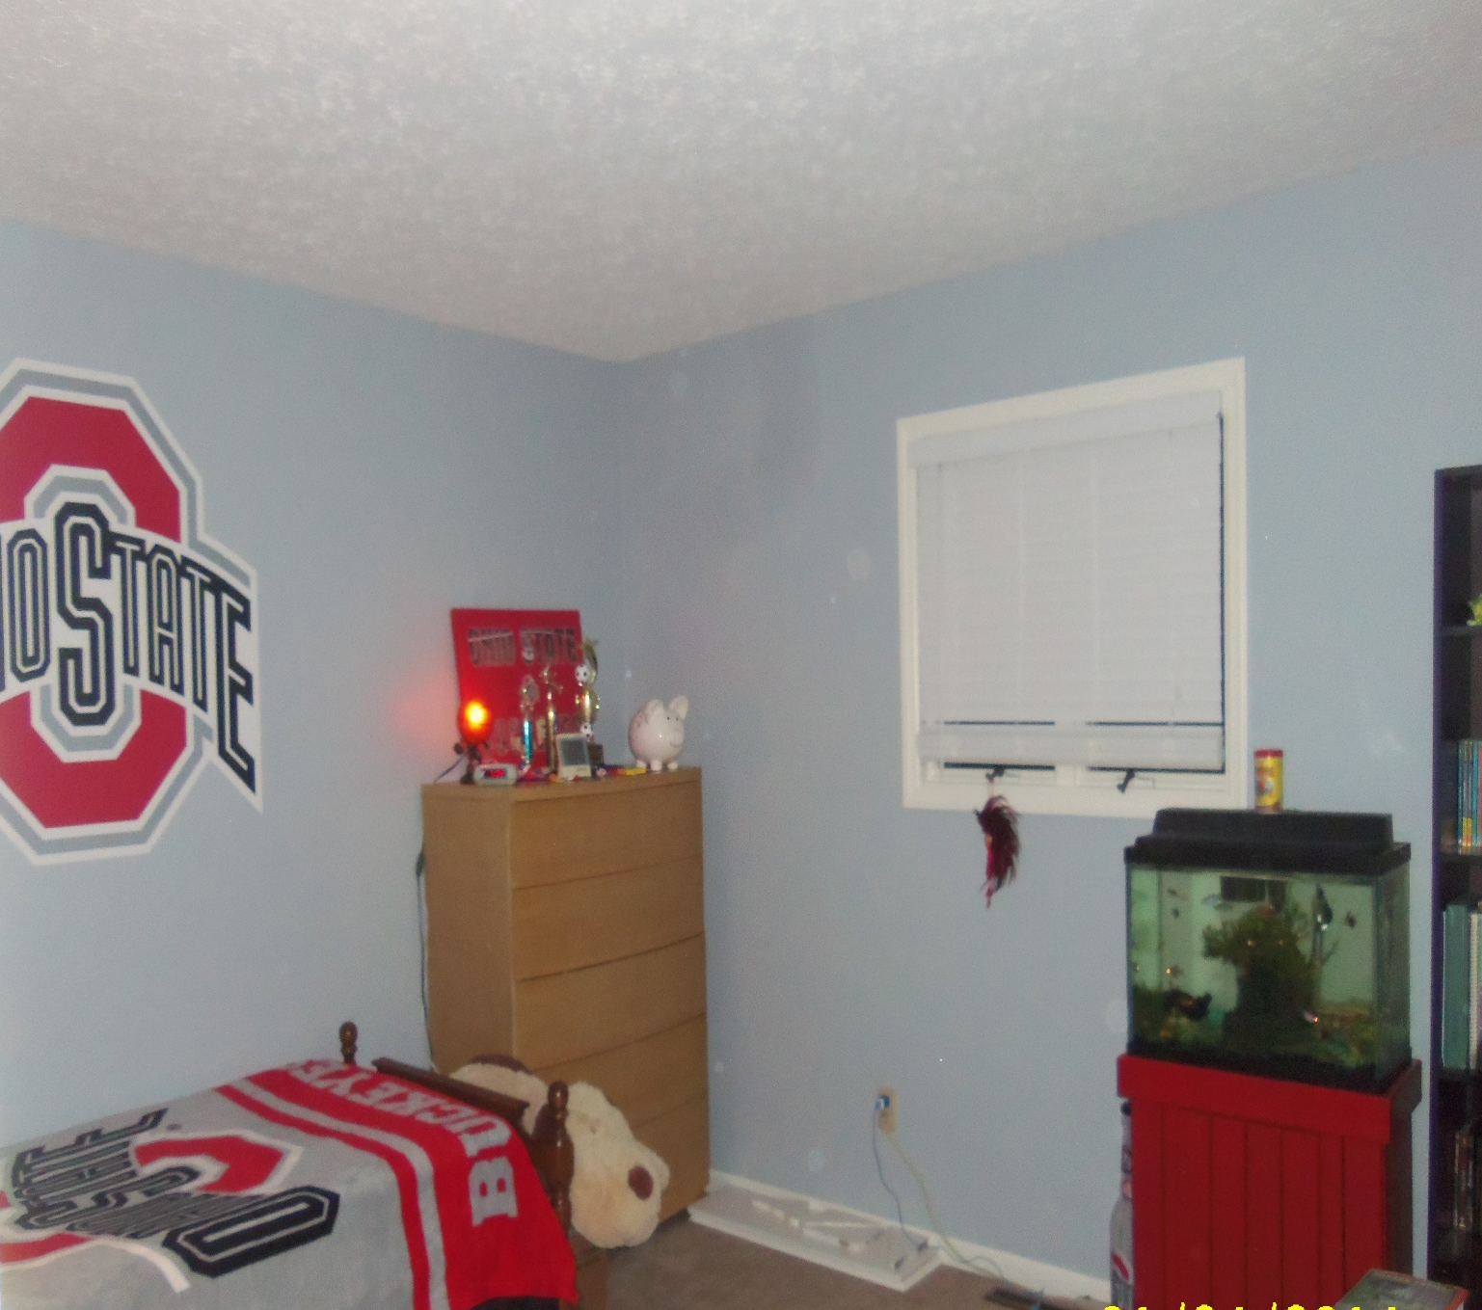
BEFORE
AFTER
AREA: KIDS BEDROOM #1

Slide 7
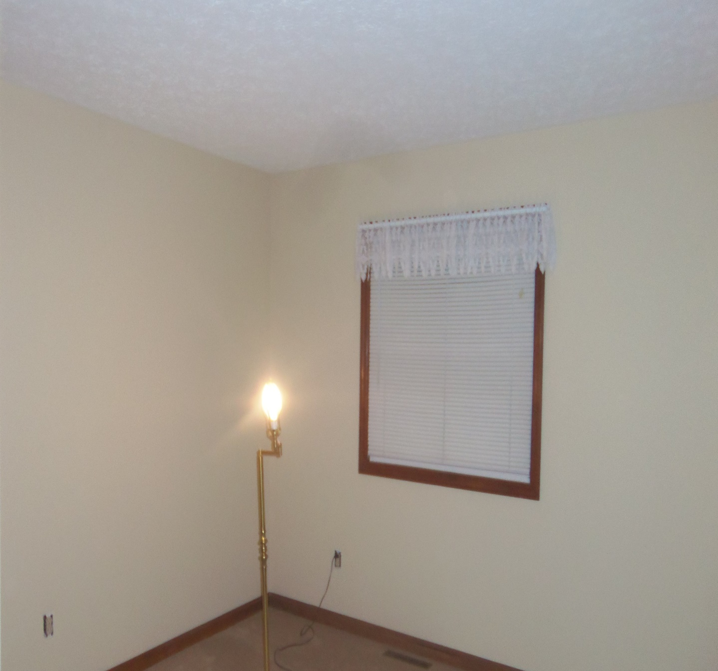
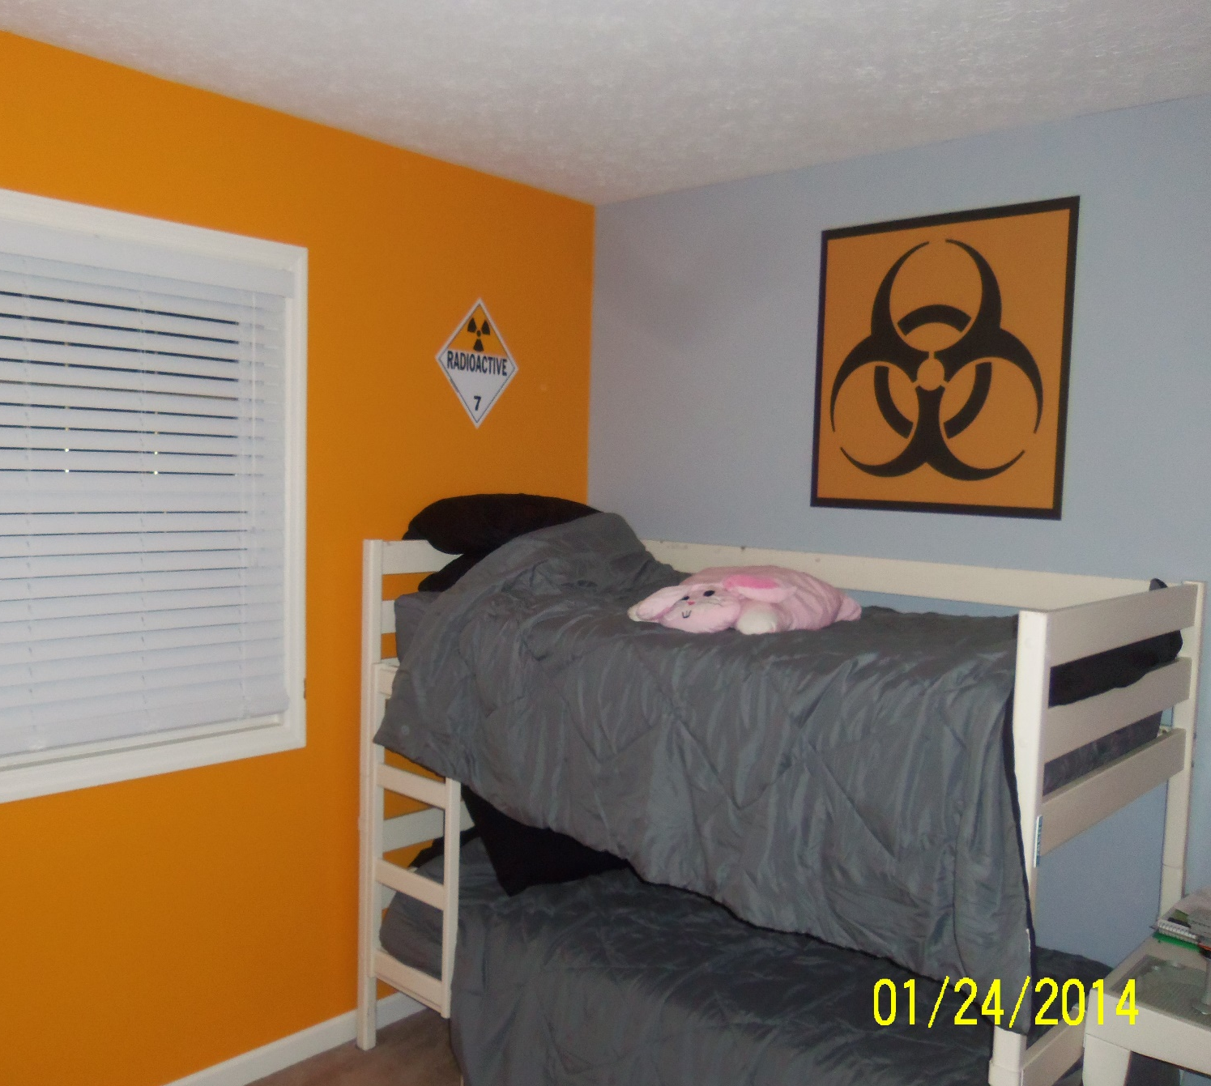
BEFORE
AFTER
AREA: KIDS BEDROOM #2

Slide 8
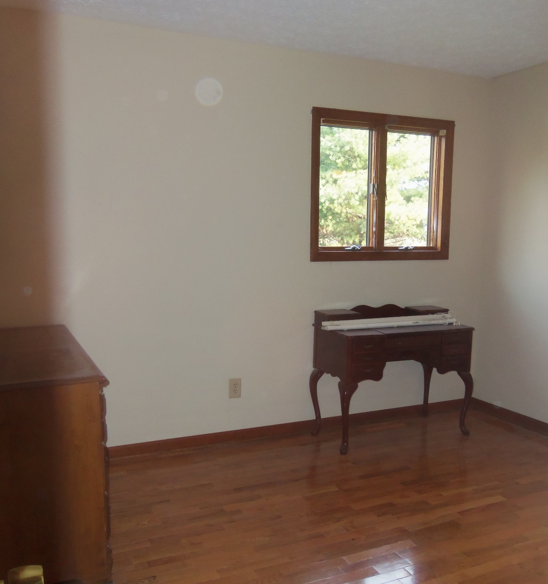
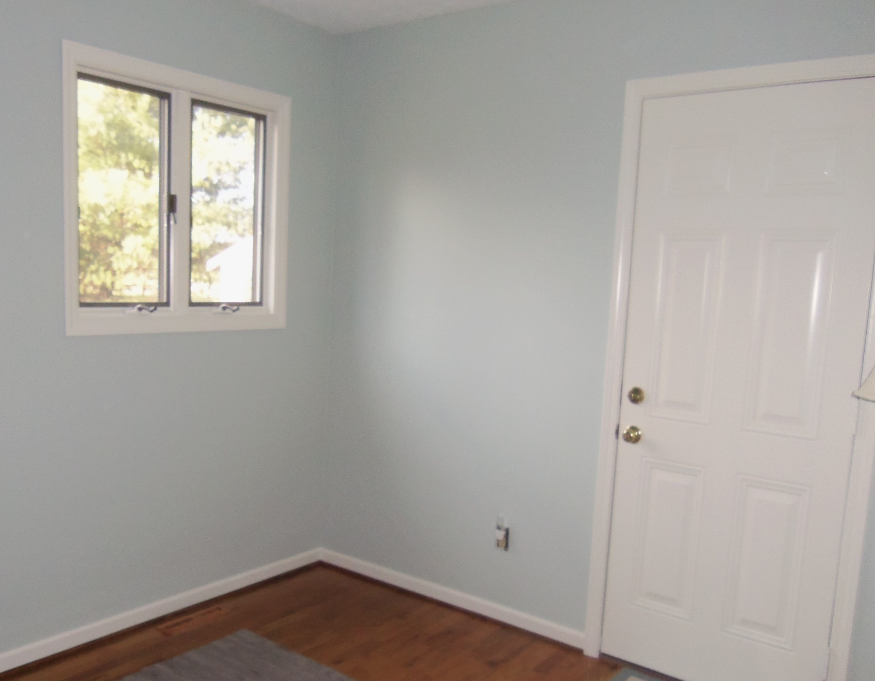
BEFORE
AFTER
AREA: SITTING ROOM

Slide 9
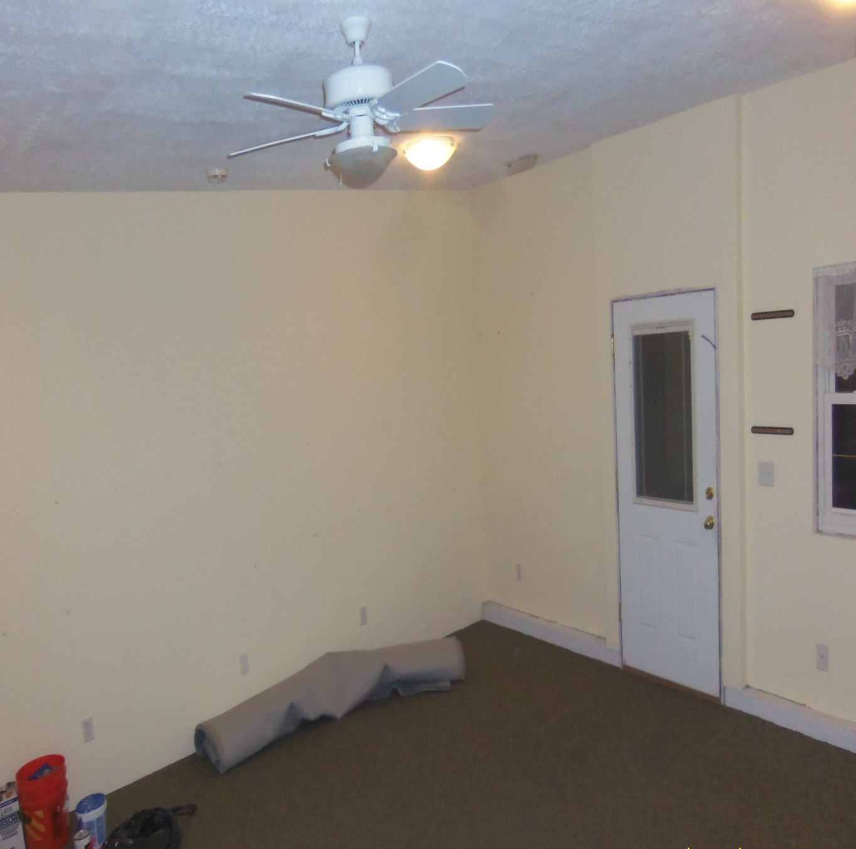
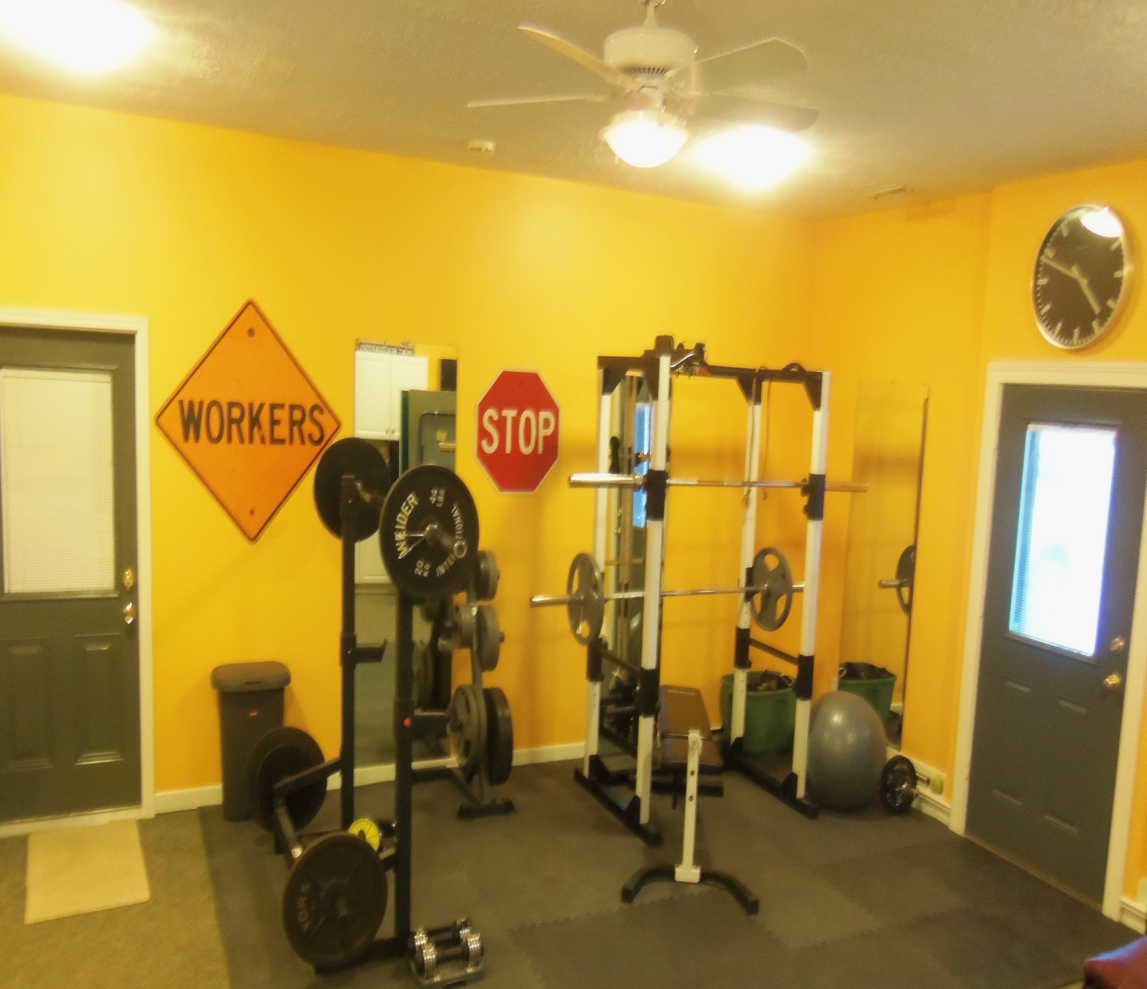
BEFORE
AFTER
AREA: GYM / RECREATION ROOM

Slide 10
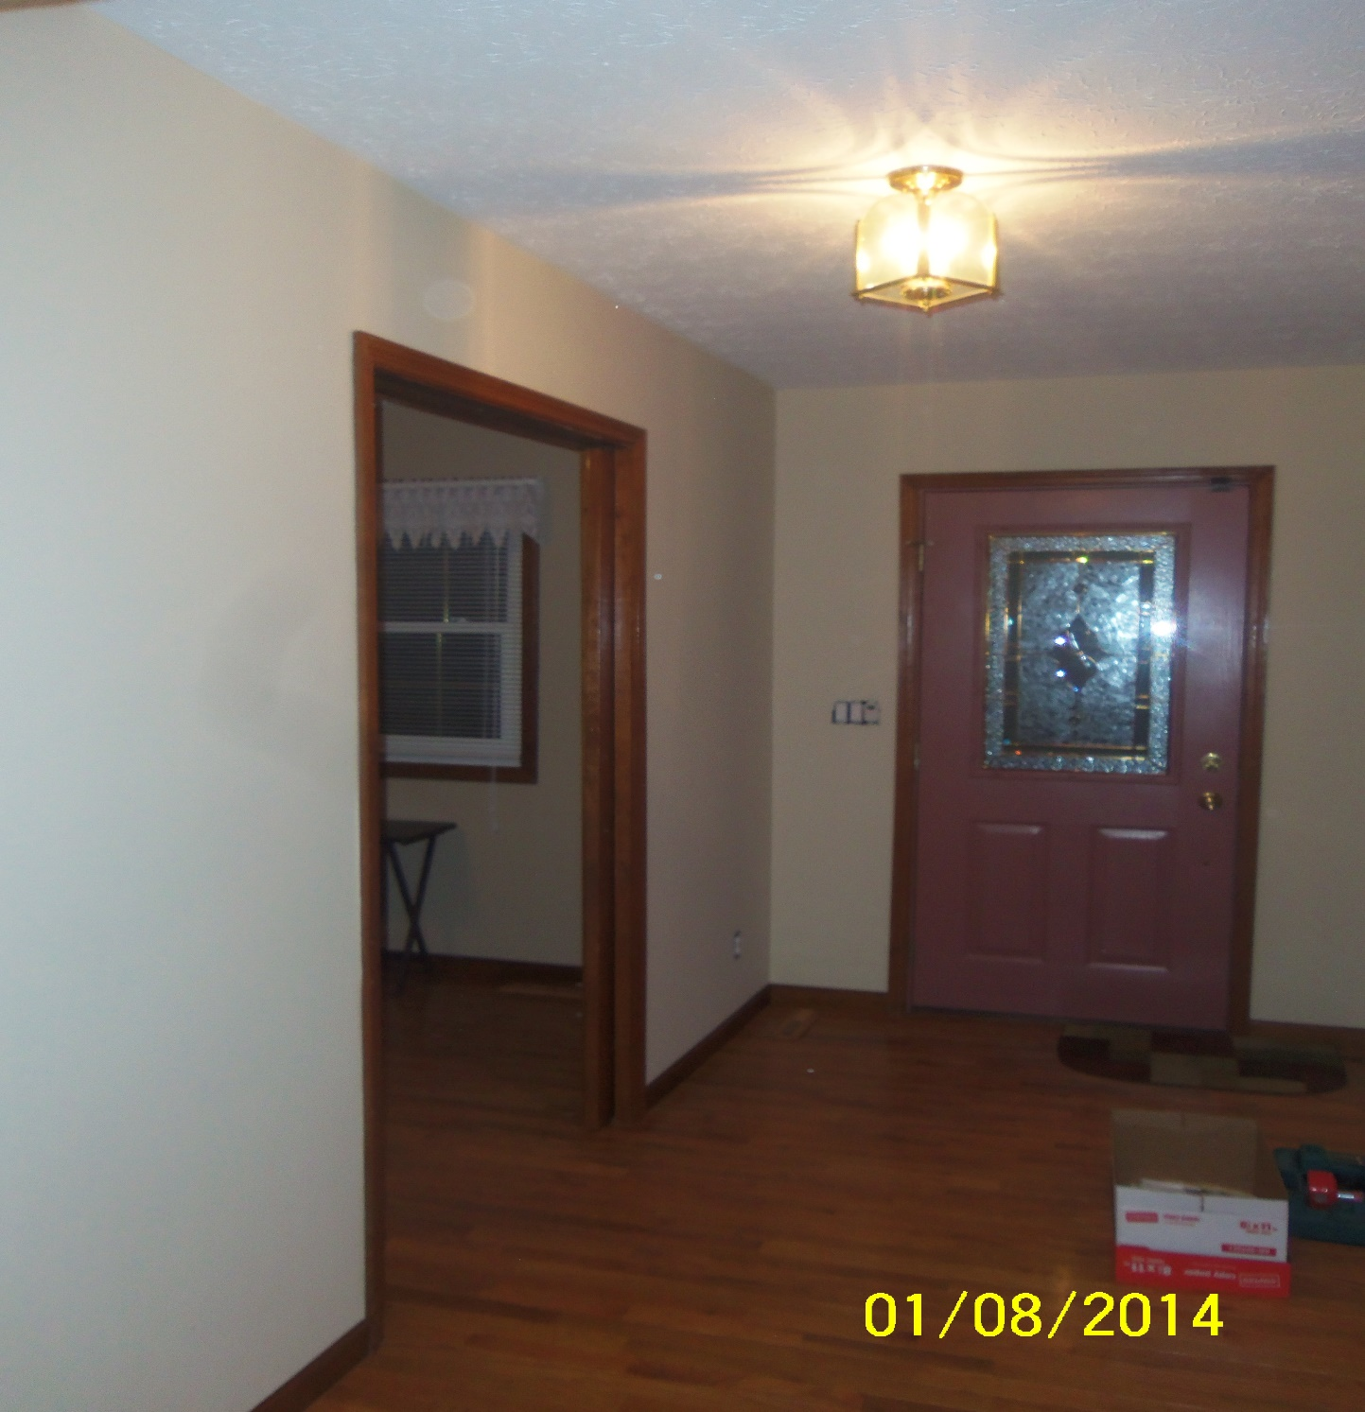
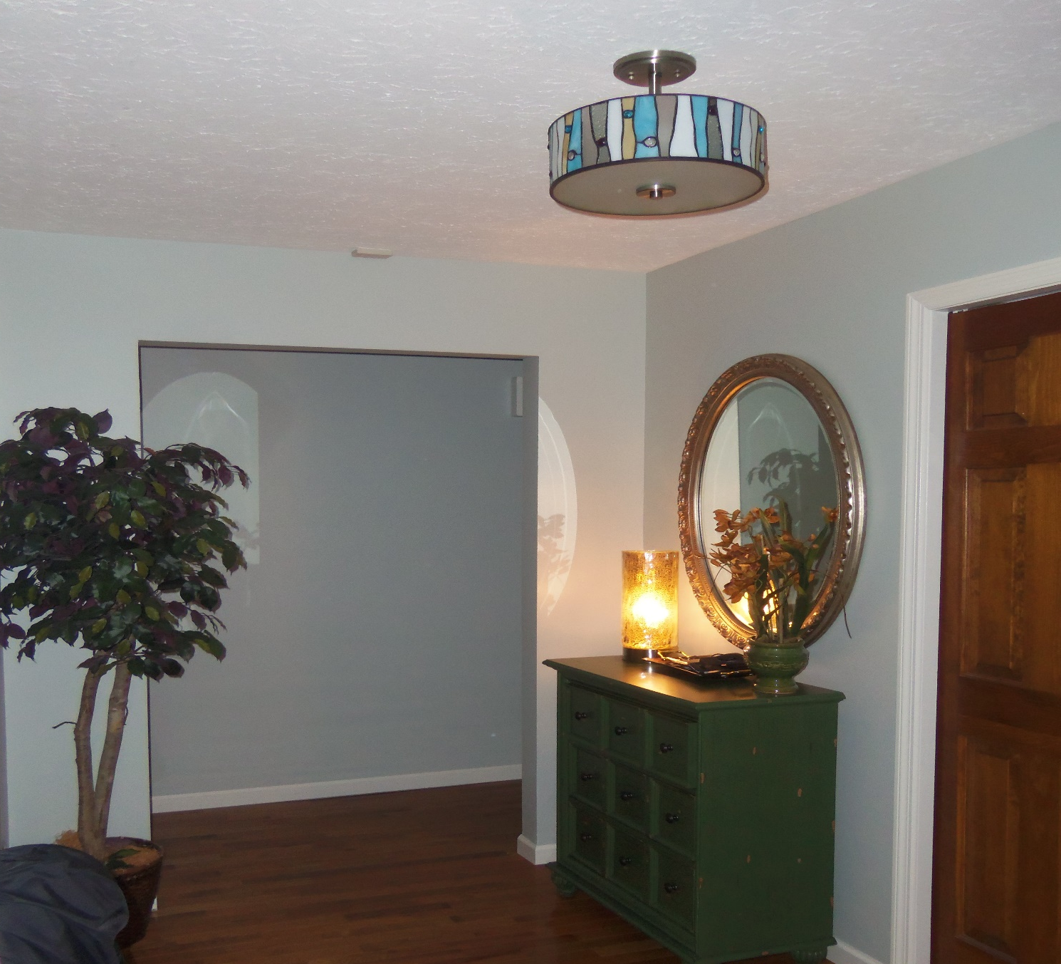
BEFORE
AFTER
AREA: MAIN ENTRY HALLWAY

